Slide 1
Spark MLLib
2

Slide 2
Stop Words
Naïve Bayes
Decision Tree
Random Forest
Support Vector Machine
Input Text
Training Set
NLP
Tokenizing
lemmatization
TF-IDF
Feature Vector
Input Text
Testing Set
Model Generated
Prediction

Slide 3
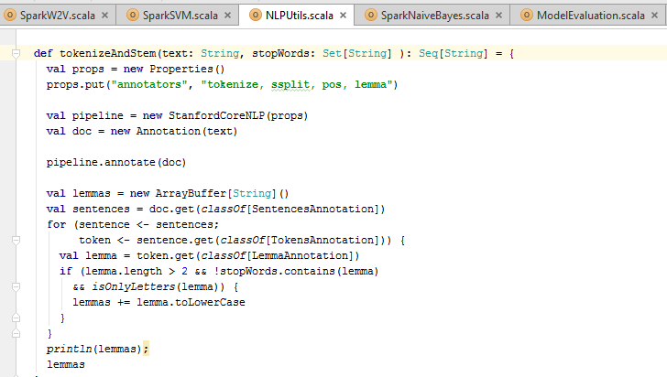
Natural Language Processing
This is done using Core NLP from Stanford (http://nlp.stanford.edu/software/corenlp.shtml)
Stop Word Removal
Lemmatization

Slide 4
Natural Language Processing : Input
If I install X11R5 with backward compatibility for motif, will motif
|>1.2 clients work on the X11R5 servers?, It works for me., I've run Motif 1.1.3,1.1.4,1.1.5,1.2,1.2.1, and 1.2.2 on

Slide 5
Natural Language Processing : Tokenization
If
I
install
X11R5
with
backward
compatibility
for
motif
,
will
motif
|
>
1.2
clients
work
on
the
X11R5
servers
?
It
works
for
me
.
I
've
run
Motif
1.1.3,1.1.4,1.1.5,1.2,1.2.1

Slide 6
Natural Language Processing : Lemmatization and Stop Words
ArrayBuffer(daniel, mccoy, subject, motifbc, organization, line, article, ray, stell, write, install, backward, compatibility, motif, will, motif, client, work, server, work, run, motif, server, motifbc, define, daniel, mccoy, space, nasa, mail, code, tel, space, center, fax, houston, texas, future)

Slide 7
Multiclass Classification

Slide 8
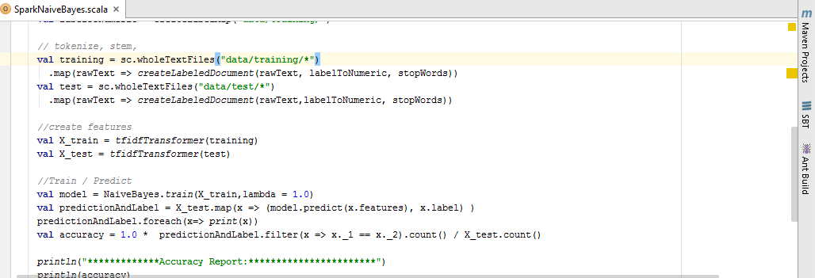
Naïve Bayes

Slide 9
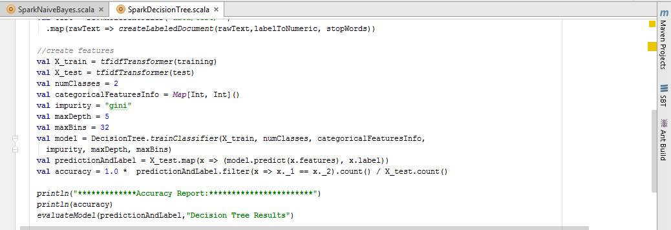
Decision Tree

Slide 10
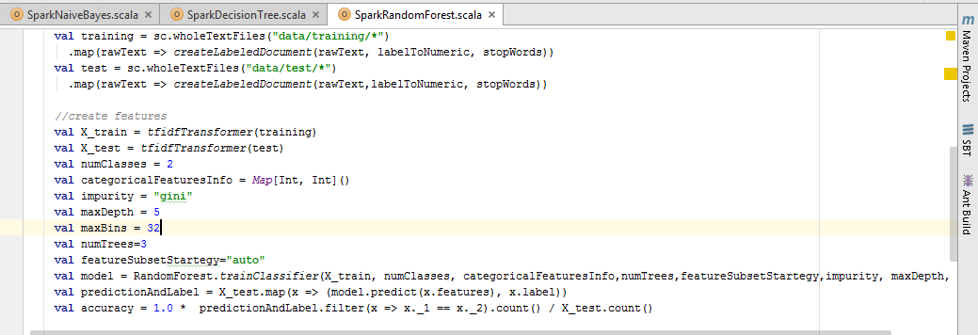
Random Forest

Slide 11
Binary Classifier

Slide 12
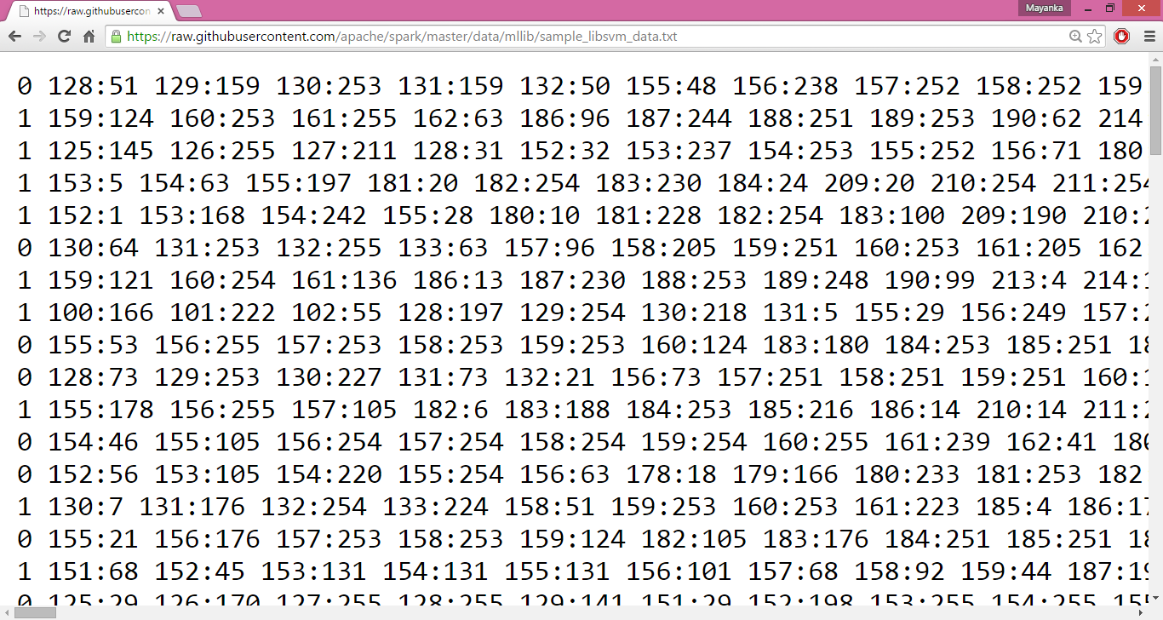
Input for SVM

Slide 13
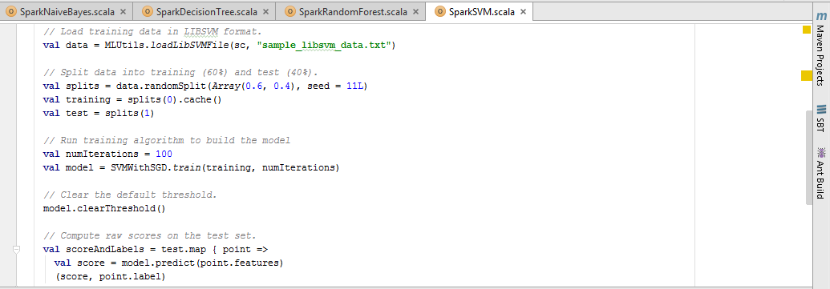
Support Vector Machine

Slide 14
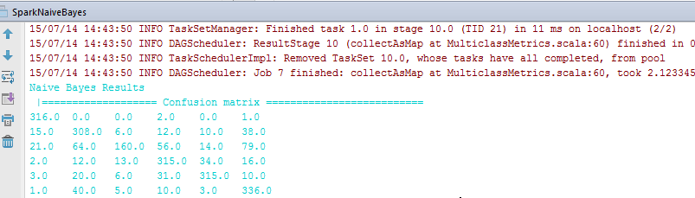
Confusion Matrix

Slide 15
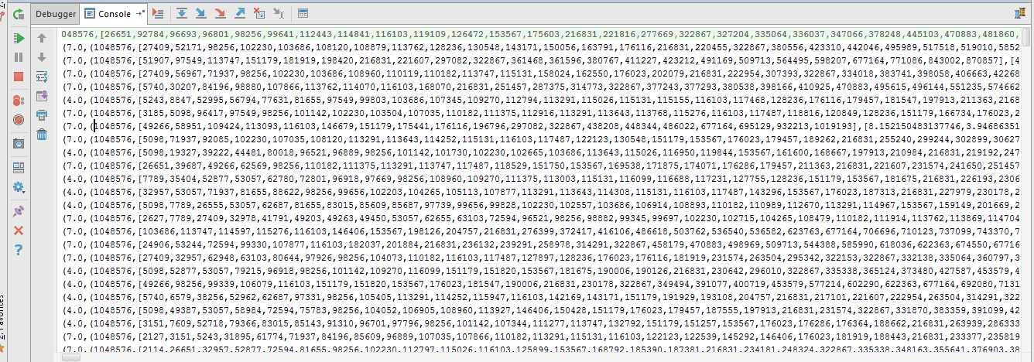
TF IDF Output

Slide 16
(7.0,(1048576,
[22748,53057,62888,68623,72594,97549,97739,99228,107866,110987,113291,114252,115131,116099,116950,118529,119844,143171,144015,146270,146406,181919,198239,198770,216831,227528,231458,263939,278320,280963,294171,315912,318331,322867,334018,351090,372636,388969,391077,396195,422887,433985,448917,451927,492924,499918,544388,584334,620233,677123,677164,695823,704097,720903,744311,760564,776224,777200,799960,812432,831779,856725,859031,867249,871039,900039,910062,911774,930117,934738,957806,962308,963154,982130,1038110,1045884],
[6.057076710435456,3.2229771885436596,11.538176432900702,5.303304908059076,1.8750265677942497,2.553021943333593,2.8686600930519637,2.8686600930519637,3.246169123893538,52.103597500887425,1.7346010553881064,5.966453315235026,1.6114885942718298,2.264400462639876,3.97763516875562,20.00409614474457,3.061344436881465,11.956095101207355,2.0727330434276836,3.7798094254257,1.9400741243207713,1.6442784170948206,2.2230152464770216,4.2863706504052335,0.1324867442625928,4.61015772749913,14.075811926894364,4.668799753476458,5.192079272948852,3.8460588109669005,14.52204415833289,19.559288001053368,6.190608103059978,0.03484050466072018,18.30540133977132,7.037905963447182,12.555823600601595,18.10240135788427,4.581170190625878,4.265317241207401,11.22620729232856,3.8460588109669005,4.2244952466871455,10.994921845000066,3.6147296750662514,1.9080072485241086,1.5517268597295755,0.9256997986430715,1.3013336659679902,7.804823495036064,0.0,4.917642427247091,20.768317091795407,2.5567884261290694,18.171230131306366,11.878587349558146,4.398848633831924,1.9462028462621446,2.322387720290225,8.0187677341404,10.606609816118151,4.447638798001355,7.4433710715553465,2.374466869335115,4.702531047630146,3.1538060292440995,3.3658336276496272,27.000895563981604,6.750223890995401,2.96603425707714,2.412933150162911,2.005291762632151,4.093466984280742,4.87842171409381,3.5313480661272005,1.8412522506756457]))
(7.0,(1048576,
[24877,81642,91310,107035,113631,113762,130679,151179,151750,163791,172039,181919,216831,217101,322867,373480,380577,423212,480992,493469,495615,509713,622363,634219,677164,680153,698946,713323,718980,777200,786541,815663,859199,904431,948830,982124,998973,1024008,1041847],
[3.4180193808201973,7.037905963447182,2.498163582781546,2.5605691489689755,5.045475798756976,2.1450537050073097,8.48939590800933,1.0951065883204811,3.4360378863228758,4.397964094065731,4.498932092388906,1.6442784170948206,0.1324867442625928,1.9360090780726018,0.03484050466072018,2.553021943333593,2.954734701823207,4.632870643525861,3.717677644318694,6.057076710435456,8.186933968561483,1.4836552227619448,3.4692021107762128,6.3447587828872365,0.0,6.190608103059978,4.111166561380142,4.111166561380142,3.521397735274032,1.9462028462621446,14.886742143110693,1.7197859696029656,3.902411747518032,3.0802724467669838,1.9523693611778086,3.409130433402951,4.0093838670702,3.561807273611909,26.108321358724766]))
(7.0,(1048576,
[32957,96803,102478,108300,110877,113291,116099,128236,172441,174445,183381,188443,200752,215995,216831,263504,271872,297769,322867,334018,380538,404225,414413,422098,463863,463937,473765,474237,580425,677164,682386,698715,708322,709991,720903,738420,894302,919249],
[1.9462028462621446,2.828250554714087,3.0007198150650303,4.640010690648811,3.6147296750662514,1.7346010553881064,2.264400462639876,1.3531930515113317,3.1460856653365554,4.185274533533865,3.0551138871308288,2.8584035928847746,3.2689838016597093,3.501789263885656,0.1324867442625928,2.477036036355671,5.303304908059076,3.8598521330992366,0.03484050466072018,2.6150573342530454,3.9130031969254384,4.16622633856317,1.6939780856470932,5.246146494219127,3.742069097442853,3.3243338967428744,2.938021220849466,3.0551138871308288,2.3935150643058094,0.0,3.8598521330992366,5.485781411525861,9.280021381297622,3.9318256327243257,2.5567884261290694,6.097843833765816,4.735320870453137,2.8686600930519637]))

Slide 17
References
https://github.com/brokendata/Spark20NewsGroup
https://github.com/logicalguess/tf-idf-spark-and-python
https://spark.apache.org/docs/latest/mllib-guide.html

